Slide 1
3D Printing by
Selective Laser Sintering
Midterm Demo
Group 12
Luis Carrillo Electrical Engineer
Michael McMahon Photonic Engineer
Michael Rogatinsky Computer Engineer
Daniel Valledor Electrical Engineer
Group 12
3D Printing by Selective Laser Sintering

Slide 2
Specifications
Print Bed Area
Laser Diode Output Power
X-Y Build Area
Laser Diode Wavelength
Print Height
Beam Focal Length
Power Source
120V Wall Power
X-Y Scanning Speed
User Interface
Local Host Server
Material Type
Sugar, Polyamides, TPE, TPU
Motor Torque
Material Size
Group 12
3D Printing by Selective Laser Sintering
Notes:
The following are the specifications defined for the SLS 3D printer.

Slide 3
Test 1 Specifications
Print Bed Area
Laser Diode Output Power
X-Y Build Area
Laser Diode Wavelength
Print Height
Beam Focal Length
Power Source
120V Wall Power
X-Y Scanning Speed
User Interface
Local Host Server
Material Type
Sugar, Polyamides, TPE, TPU
Motor Torque
Material Size
Group 12
3D Printing by Selective Laser Sintering
Notes:
Test 1 will satisfy the following highlighted specifications.

Slide 4
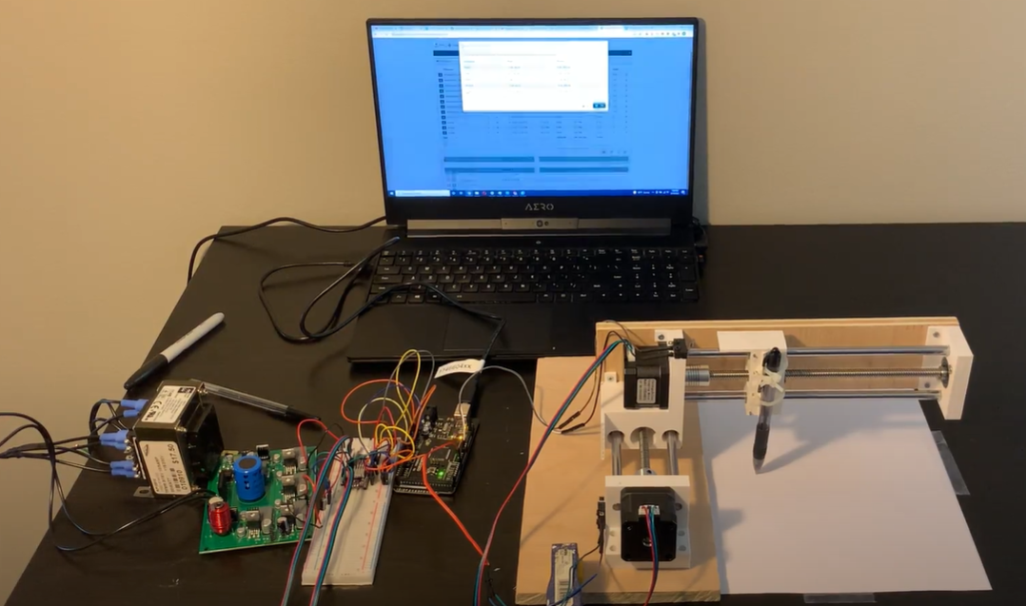
Test 1 Description
Purpose: To test the x-y scanning system, the Repetier firmware and local host server, and the power module.
Test Model: “Smiley”
Slicer Used for Test: Cura 4.13.1
Main Components Used in Test 1
X-Y Track System
Complete Power Module PCB and Transformer
Stepper Motor Driver Modules
Arduino MEGA Development Board
Computer (for local host server)
“Smiley” Model
Test 1 Setup
Group 12
3D Printing by Selective Laser Sintering
Notes:
The purpose of Test 1 is to test the x-y scanning system, the Repetier firmware and local host server, and the power module. We developed a model called “Smiley” to test the scanning system. The slicer used for the test was an open-source slicer called Cura. The stl file for “Smiley” is uploaded to Cura and Cura coverts it to the necessary G-code. The G-code is then uploaded through the Repetier’s User Interface and the print is initiated. A pen is attached to the base of the x-y track system to draw the future laser path. The main components used in Test 1 are the X-Y track system, the complete Power Module PCB, the stepper motor driver modules, the Arduino mega development board, and the computer to host the local server.

Slide 5
Test 1 Video
Record Voice Over Here
Group 12
3D Printing by Selective Laser Sintering
Notes:
The following is the video of Test 1. After uploading the gcode, we initiated the print. The first segment of the video shows the calibration sequence of the x-y scanner. After calibration, the scanner will begin to draw the initial layer. The test also demonstrates that the power module can successfully convert wall power into regulated DC voltage and supply the necessary DC power for complete stepper motor operation. The test will continue until it reaches the midpoint of the second layer. From there, we will compare the final results with the “Smiley” model.

Slide 6
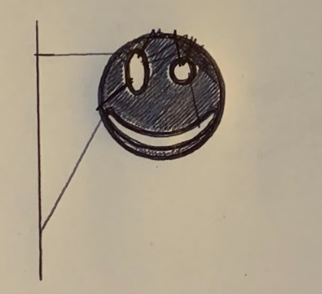
Test 1 Results
29 mm
“Smiley” Model
X-Y Scanner Test Results
Group 12
3D Printing by Selective Laser Sintering
Notes:
The resulting image for test 1 is shown in the figure to the right. In order to calculate the actual scanning speed of the printer, we took the video segment where the x-y scanner drew the outer circumference of Smiley and divided it by the time it took to draw. The measured diameter of Smiley is 29 mm. Therefore, the calculated circumference of the circle is 91.106 mm. The scanner took 66 frames to draw the circle which is equivalent to 2.2 s. By dividing the distance over time, we found the scanning speed to be 41.41 mm/s which is greater than our required 30 mm/s

Slide 7
Test 2 Specifications
Print Bed Area
Laser Diode Output Power
X-Y Build Area
Laser Diode Wavelength
Print Height
Beam Focal Length
Power Source
120V Wall Power
X-Y Scanning Speed
User Interface
Local Host Server
Material Type
Sugar, Polyamides, TPE, TPU
Motor Torque
Material Size
Group 12
3D Printing by Selective Laser Sintering
Notes:
For the second test, we’ll be testing that the dimensions of the print bed are within spec. This will include the x and y axes as well as the z travel distance.

Slide 8
Test 2 Description
The X and Y axes of the print bed must each measure 10 cm ± 0.5 cm
The Z axis must have a total travel distance of no less then 9.5 cm
Testing will be conducted using a tape measure to ensure the correct dimensions are met.
The Z axis will be moved across its range of motion to check that its travel distance matches with the measurements.
Group 12
3D Printing by Selective Laser Sintering
Notes:
We’ll be checking that the x and y axes are each 10 cm, but a 0.5 cm margin of error will be considered acceptable. The Z axis will also need to be able to move at least 1.5 cm, but any amount more then that will be okay too.
To test this, we will first move the z axis close to its lowest point to ensure that it can safely travel that far. Once we know the travel distance for the z axis, all axes can simply be measured with a tape measure to check for compliance.

Slide 9
Test 2 Video
Record Voice Over Here
Group 12
3D Printing by Selective Laser Sintering
Notes:
Here we can see the z-axis motion of the printer. In addition to validating the compliance of the print dimensions, this is also an important functionality of the printer as a whole. Note that as the print bed on the left moves down for the next layer, the reservoir bed on the right moves up to provide new material for printing. When the sweeper mechanism is added, this will allow new material to be placed at each layer for both printing and supports.
Now, with the bed nearing its lowest point, we can measure its travel distance to verify the specification.

Slide 10
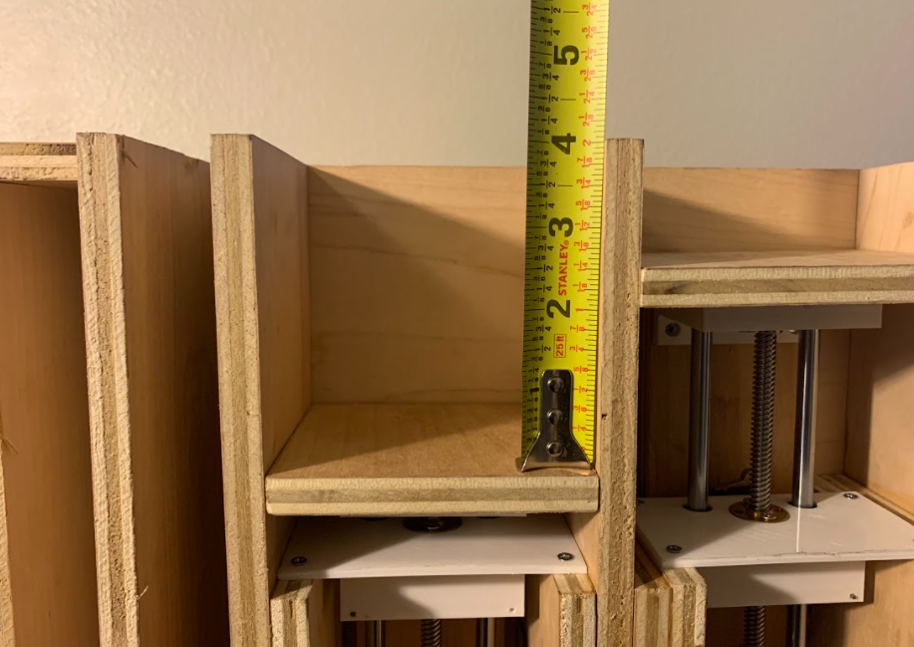
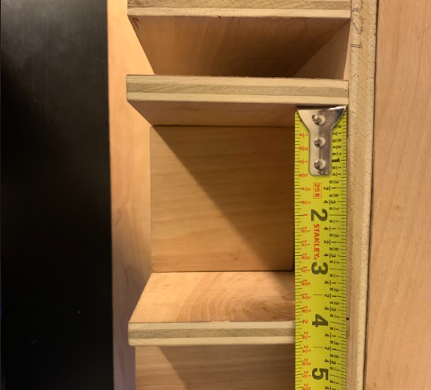
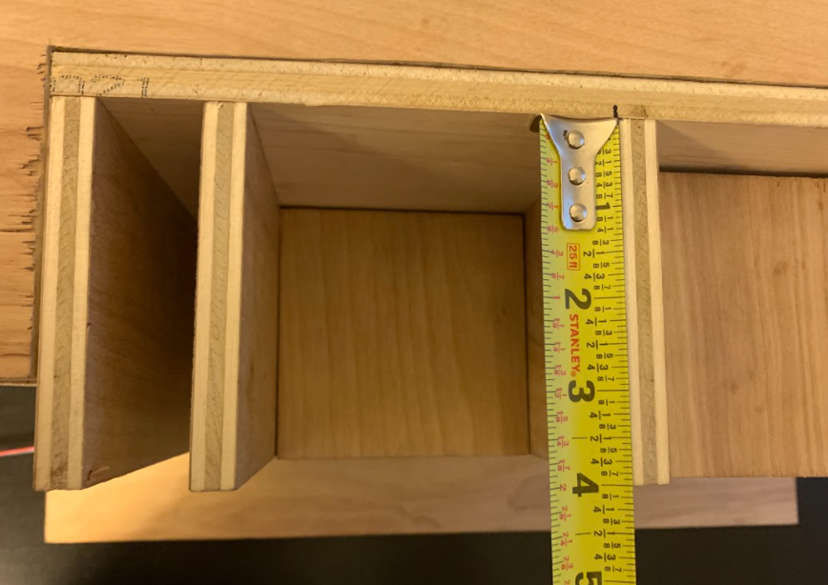
Test 2 Results
Z-Axis Measurement
X-Axis Measurement
Y-Axis Measurement
Note: 4 in = 10.16 cm
All dimensions are within acceptable margins.
Group 12
3D Printing by Selective Laser Sintering
Notes:
Here we see the measurements for all dimensions are just under 4 inches or almost exactly 10 cm

Slide 11
Test 3 Specifications
Print Bed Area
Laser Diode Output Power
X-Y Build Area
Laser Diode Wavelength
Print Height
Beam Focal Length
Power Source
120V Wall Power
X-Y Scanning Speed
User Interface
Local Host Server
Material Type
Sugar, Polyamides, TPE, TPU
Motor Torque
Material Size
Group 12
3D Printing by Selective Laser Sintering

Slide 12
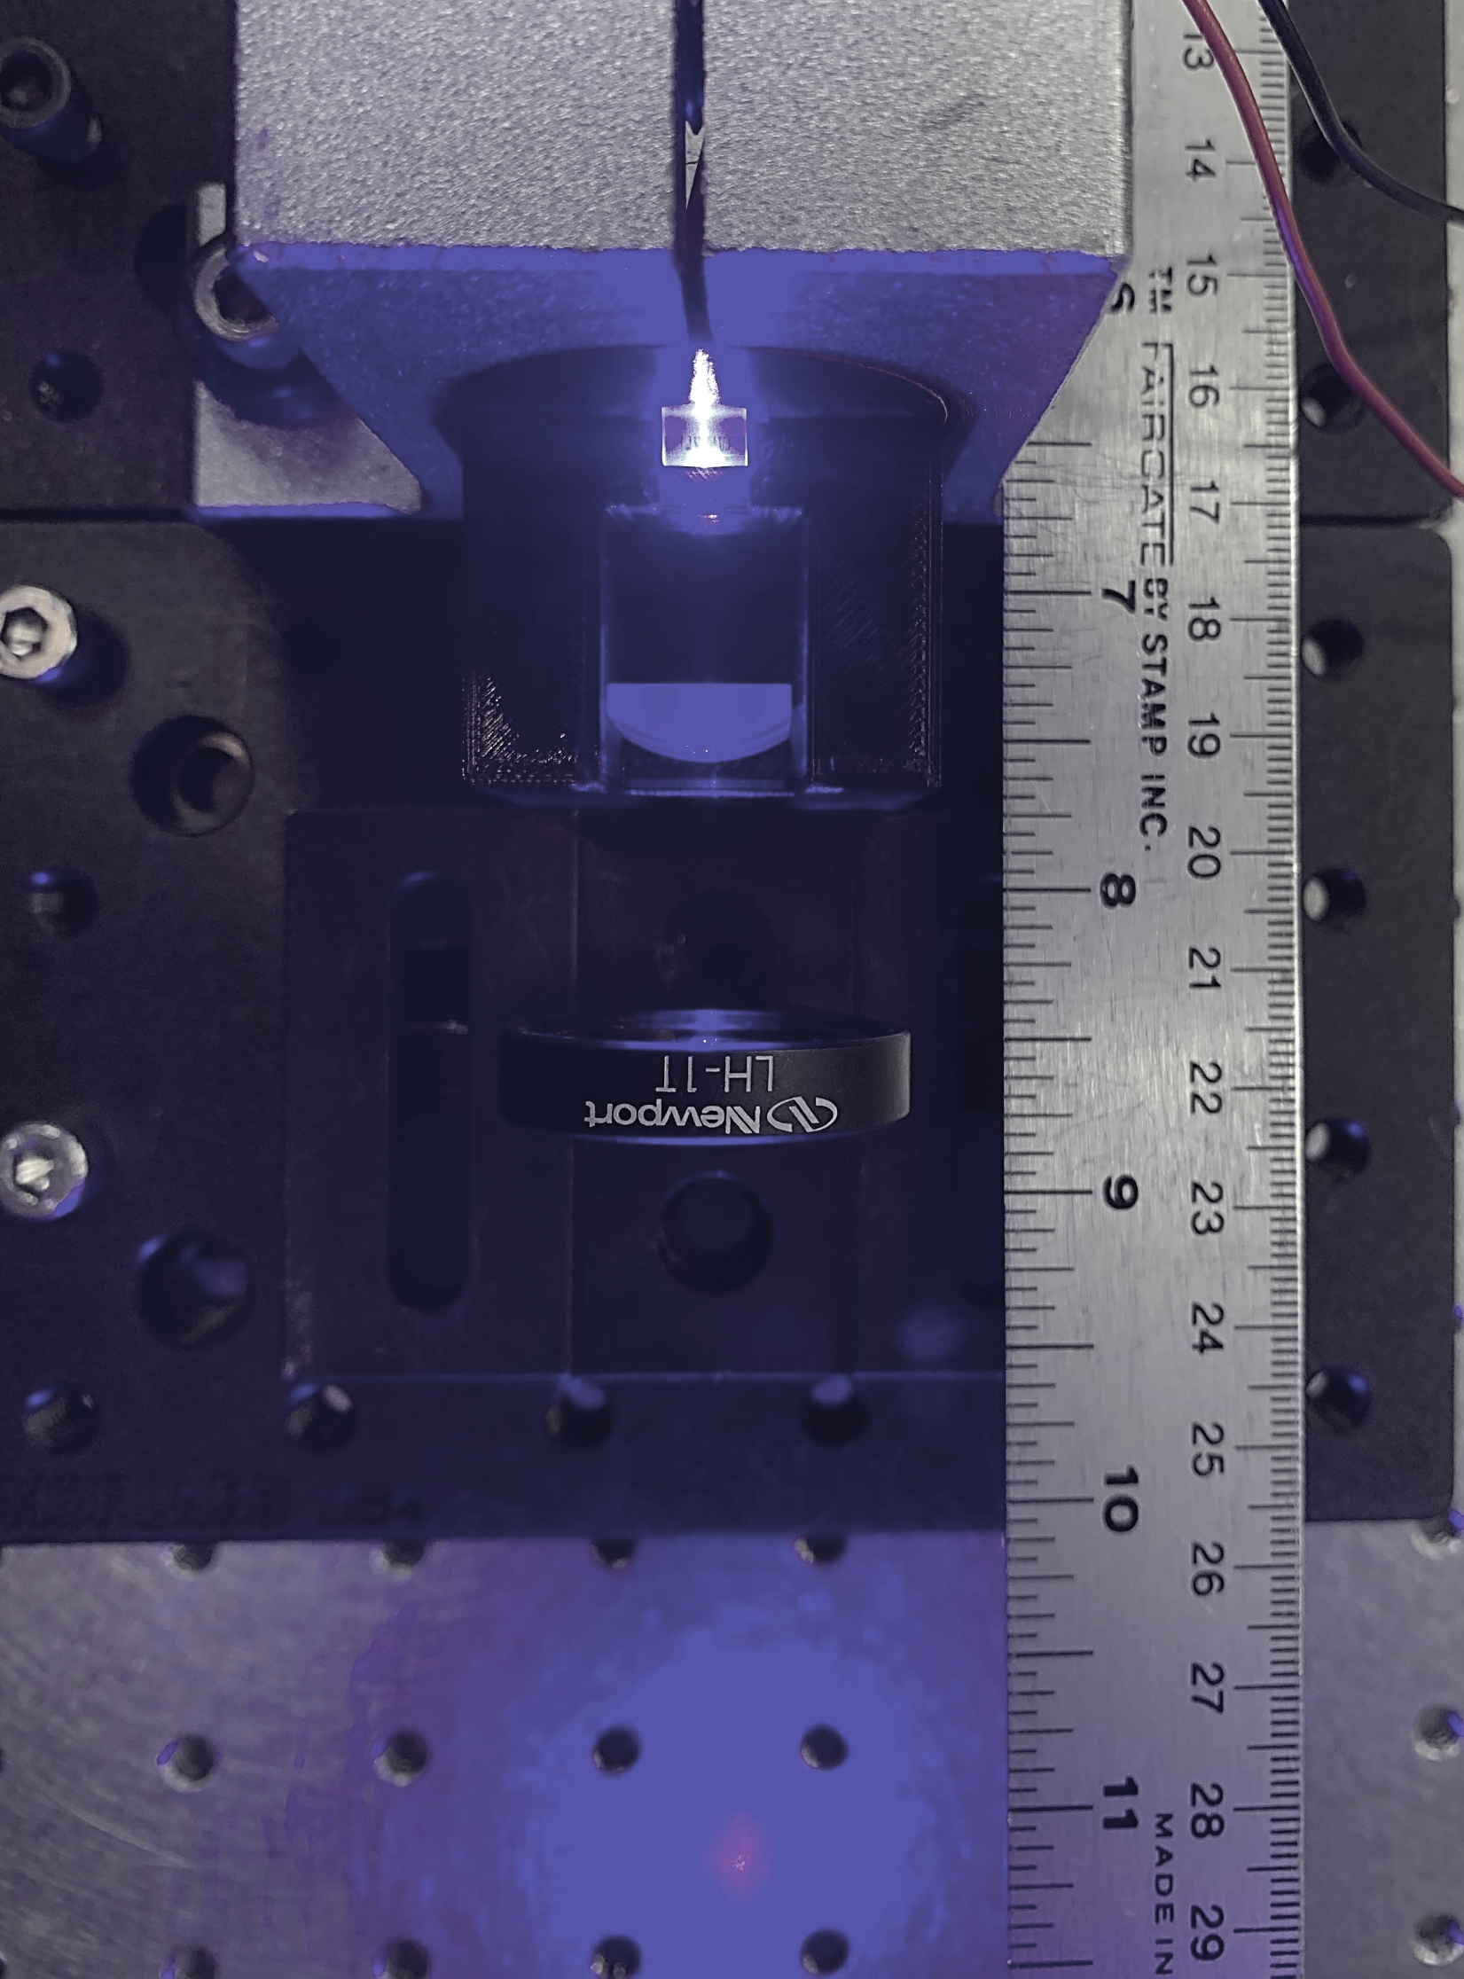
Test 3 Results
Layout of Laser Module without final housing, top-down view
Laser beam wavelength determined by StellarNet BLUE-wave spectrometer
Aluminum CNC Housing (testing only)
Copper Heatsink
447.39 nm
Laser Diode
Cylindrical Lens 1
Cylindrical Lens 2
Focusing Lens
Group 12
3D Printing by Selective Laser Sintering

Slide 13
Test 3 Results
Fast-axis Corrected Beam Shape
Fast- and Slow-axis Corrected Beam Shape
Addition of Focusing Lens
Final Image at 75 mm
Original Beam Shape
Spherical aberrations
Focusing direction
Focusing direction
iPhone Images
Filtered Images
Spherical aberrations can be cleaned by introducing
aperture stop
Group 12
3D Printing by Selective Laser Sintering

Slide 14
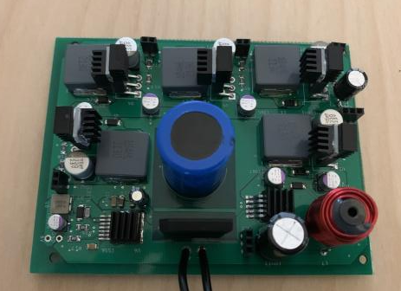
State of the PCBs
PCB | Completion Status | Verification Status
Power Module | Complete | Complete
Laser Driver Module | Complete | Partial, Awaiting Final Diode Testing
Stepper Motor Driver Module | Partial, Rev. B sent to manufacturing | N/A
MCU Module | Partial, Rev. B sent to manufacturing | N/A
Power Module PCB
Laser Driver Module PCB
Group 12
3D Printing by Selective Laser Sintering
Notes:
The electrical system is split into 4 different PCB modules: Power delivery, Laser Driver, Stepper Motor Driver, and MCU. At the moment the power and laser modules have been completed. At the top right we have the power pcb which has been verified. Bottom right we have the laser driver which is waiting for final diode testing. As for the other two, we encountered some issues on the first revision and a second revision is being manufactured.

Slide 15
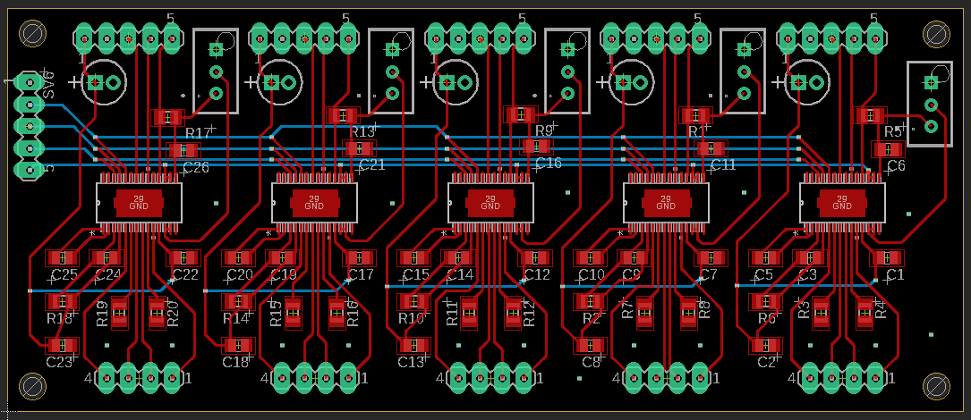
PCB Issues: Stepper Motor Driver Module
Initial Design | Issue | Solution
SLEEP and RESET are tied to built-in 3.3V regulator. | 3.3 Regulator doesn’t work unless SLEEP and RESET are set to HIGH | External enable signal for SLEEP and RESET
VREF used a set voltage divider and was shared across every driver | All drivers depend on VREF to work. Can’t adjust full-scale current after fabrication. | Use a trim potentiometer for every driver.
No input electrolytic capacitor. | In-rush current causes immediate chip shutdown | Use a 10uF electrolytic capacitor for each driver supply voltage.
Stepper Motor Driver Module - Rev B PCB Layout
Group 12
3D Printing by Selective Laser Sintering
Notes:
The initial design for the Stepper Motor Driver Module did not work. After troubleshooting and referring to IC documentation, we were able to deduce the issues. The first issue was that the built-in 3.3V regulator was tied to the pins responsible to enable the chip. After testing, we found that the 3.3V regulator only turns on when the chip is enabled therefore, we need an external enable signal. The second issue was with the reference voltage used to set the full-scale current. Initially, the reference voltage used a set voltage divider and was shared across every driver. We found that it would be better to isolate each reference voltage and have the ability to change the reference voltage after fabrication. Therefore, we added a trim potentiometer for each driver. Lastly, we found that the in-rush current can cause immediate chip shutdown. When using the test modules, it is recommended to use a 10uF electrolytic capacitor. In Revision B of the driver module, we will place a 10uF electrolytic capacitor to the supply voltage trace. Revision B of the stepper motor driver module is shown to the right.

Slide 16
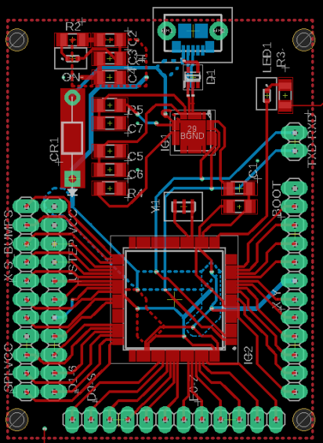
PCB Issues: MCU Module
Initial Design | Issue | Solution
Micro USB port D+ and D- pins connected to the USB to UART bridge | USB D+ & D- differential impedance requirement not accounted for | Trace D+ and D- as a 90ohm differential pair
CP2102 DTR pin connected to ATmega Reset pin through a 100nF capacitor | 100nF does not provide sufficient pull-down time for DTR active low | Use a 10uF capacitor
MCU Module - Rev B PCB Layout
Group 12
3D Printing by Selective Laser Sintering
Notes:
In the MCU modules we encountered issues with the USB to UART communication. In The USB port, Dp and Dn are channels for a single signal where Dn is just the inverse of Dp. This provides noise immunity, but it creates the requirement of D+ and D- being a 90ohm differential pair. This was not considered in the first iteration of the design. Using SaturnPCB toolkit we can calculate the trace widths and spacing to stay within 15% of the 90ohm differential impedance requirement. Additionally, the DTR pin sends and active low signal to the reset pin of the Atmega. Since the reset pin is pulled up to Vcc with a resistor, DTR sends the ground signal via a capacitor that will maintain the pin low for a certain time. The 100nF capacitor did not meet this criteria and thus we replaced it with a 10uF capacitor. This issue was proved solved by using an external HiLetgo USB to Uart module

Slide 17
Remaining Actions and Timeline
Task | 3/24/22 | 3/31/22 | 4/7/22 | 4/14/22
Enclosure Shield
Powder Delivery Testing
Rev B PCB Completion and Verification
Final Laser Module and Mounting
Sintering Testing
Group 12
3D Printing by Selective Laser Sintering
Notes:
At this point there are just 5 steps that we need to complete. These are:
Building an enclosure shield that protects the user and bystanders from the laser. It will include a laser shield that allows for safe inspection of the print and be completed by march 24th
By the same date Powder Delivery testing will be completed
Assembly and verification of second revisions for MCU and Laser Driver PCBs by March 31st
Finalize Laser Module and Full Printer Assembly by March 31st
Sintering testing from at least March 31st until April 14th

